Slide 1
OpenGL
Open Graphics Library

Slide 2
History

Slide 3
OpenGL 1.0 (1992)
Basic Features for all Graphics Cards

Slide 4
OpenGL 1.0 (1992)
Want support for your graphics card feature?
Write Extensions!!!

Slide 5
OpenGL 1.1 (1997)
Texture Objects

Slide 6
What is Texture then?

Slide 7
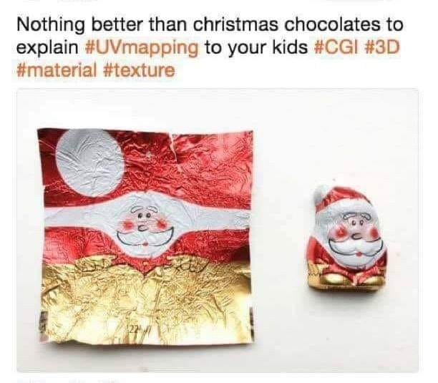
What is Texture then?

Slide 8
OpenGL 1.2 (1998)
“Image Subset” for image processing

Slide 9
OpenGL 1.3 (2001)
More Texturing Features
Texture Compression
Multisampling
Multitexturing

Slide 10
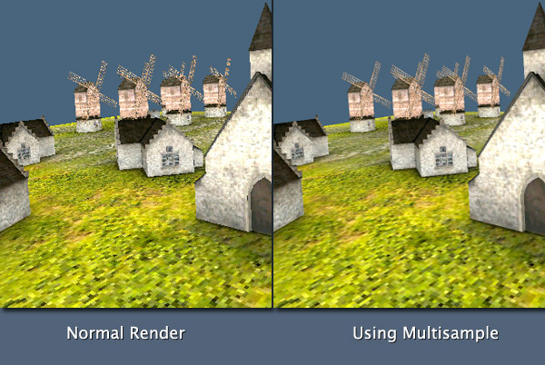
Multisampling

Slide 11
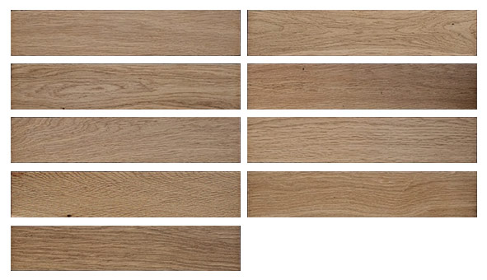
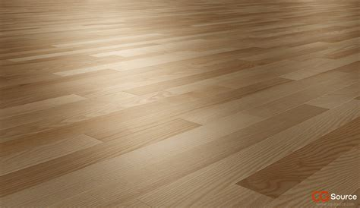
Multitexturing

Slide 12
OpenGL 1.5 (2003)
GLSL (OpenGL Shading Language)

Slide 13
OpenGL 2.0(2004)
C-like GLSL

Slide 14
OpenGL 3.0 (2008)
Deprecating Features
  Fixed Functions
  glBegin and glEnd
  GLSL v1.1 and v1.2

Slide 15
older <- 3.0 VS 3.1 -> newer
Traditional (Fixed 😞)
  1. glBegin
  2. Give data to GPU
  3. glEnd
NEW! (programmable)
  VAO & VBO
  Vertex Shader!!!!
  Fragment Shader!!!!
  And So much Fun!

Slide 16
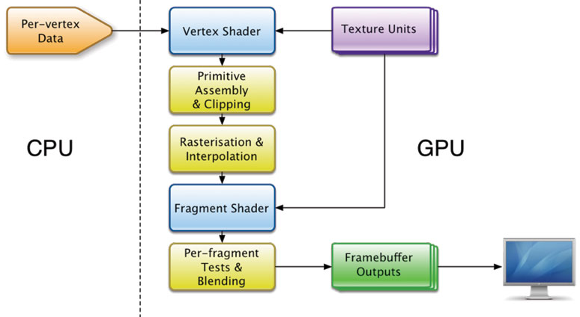
Simple Graphics Pipline

Slide 17
Demo Time!
https://www.shadertoy.com

Slide 19
What is Mingw ?

Slide 20
Not related to OpenGL
What is Mingw ?
Minimalist GNU for Windows

Slide 21
So I can only do OpenGL stuffs in Mingw?

Slide 22
GUI System
Win32 (legacy)
QT Framework (old but has nice features)
GTK+
GLUT or FreeGLUT
GLFW

Slide 23
What about Android and IOS?

Slide 24
OpenGL ES!!!

Slide 25
OpenGL ES 1.0 (2003)
It only supports Fixed Function Pipeline
Features are same as OpenGL 1.3

Slide 26
OpenGL ES 2.0 (2007)
Same features as Destop’s OpenGL 2.0
But with Programmable Pipeline
  Vertex Shader
  Fragment Shader

Slide 27
OpenGL ES 3 (2012-2014-2015)
Acceleration for advanced visual effects
Ericsson Texture Compression (ETC2)
Enhanced Texturing
Easier to write portable applications
Geometry and Tessellation Shaders

Slide 28
GLES 2.0 vs GLES 3.*
Which one is better?

Slide 29
OpenGL ES 3.0 and 3.1 and 3.2 and..?
Bad Implementations
Not Optimized
Poor mobile support (drivers)

Slide 30
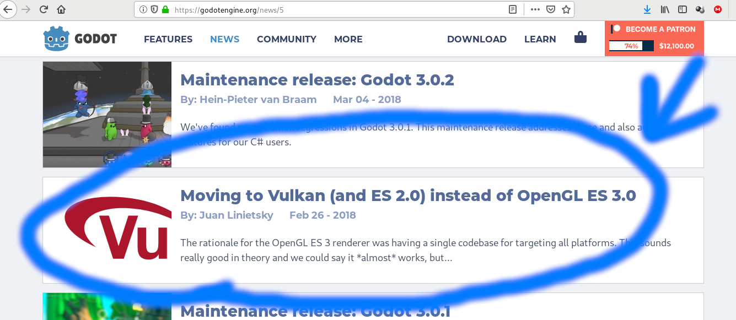
https://godotengine.org/article/abandoning-gles3-vulkan-and-gles2

Slide 31
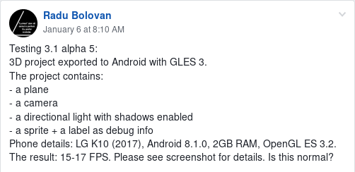
https://www.facebook.com/groups/godotengine/permalink/1455540687915854/

Slide 32
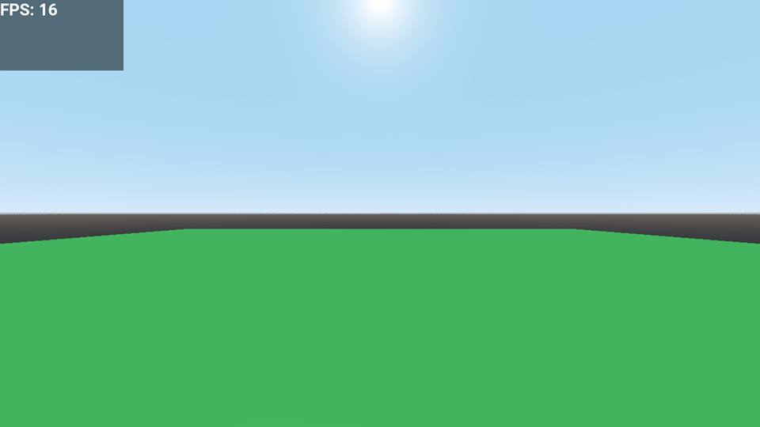

Slide 33
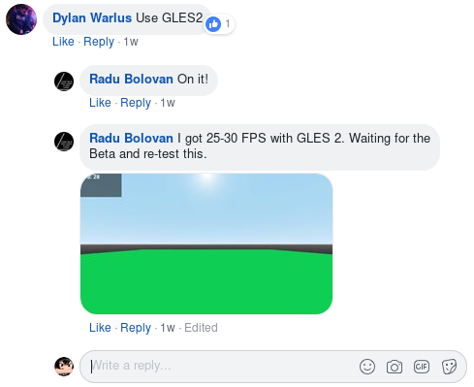
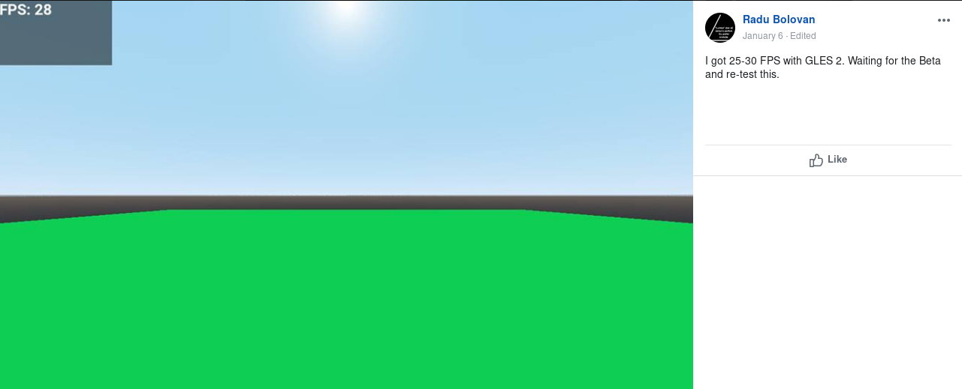
https://www.facebook.com/groups/godotengine/permalink/1455540687915854/

Slide 34
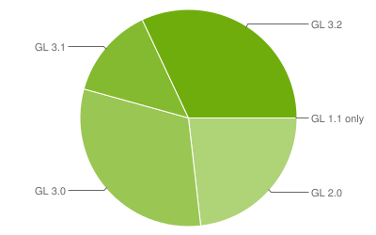
OpenGL ES for Android
https://developer.android.com/about/dashboards/#OpenGL

Slide 35
OpenGL ES 3.* for Android
Supported but not runnable
Can be run only on a handful of high-end devices.

Slide 37
Alternatives To OpenGL
DirectX (Only Windows and Xbox…. Not really)
  https://store.steampowered.com/linux
  https://store.steampowered.com/steamos
Metal (Apple)
Vulkan (new)

Slide 38
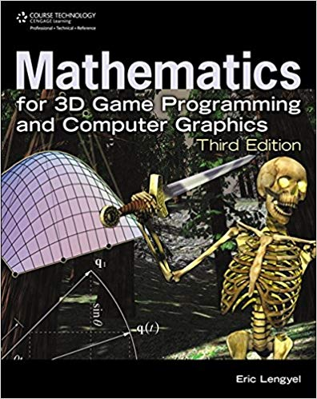
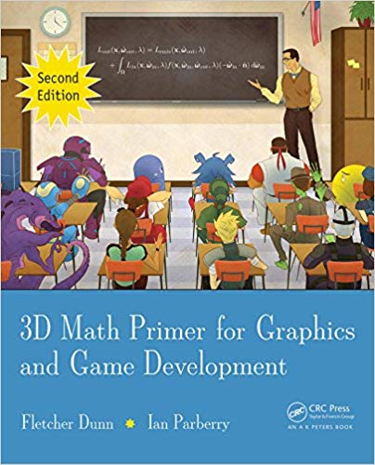
Are you book worm?
Beginner

Slide 39
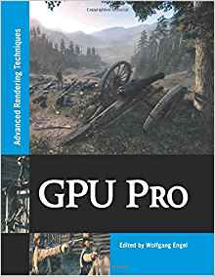
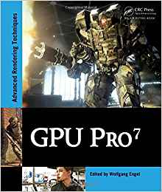
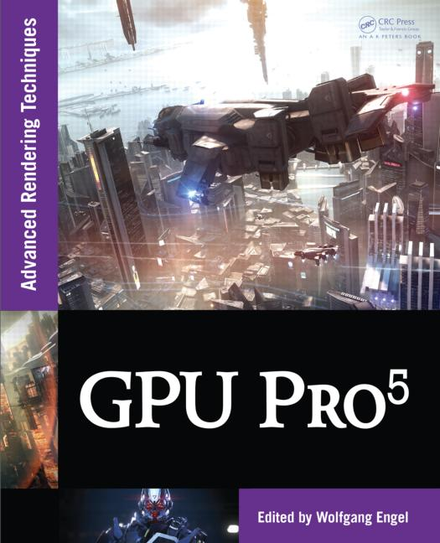
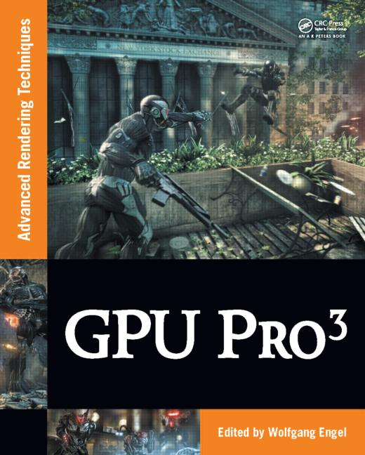
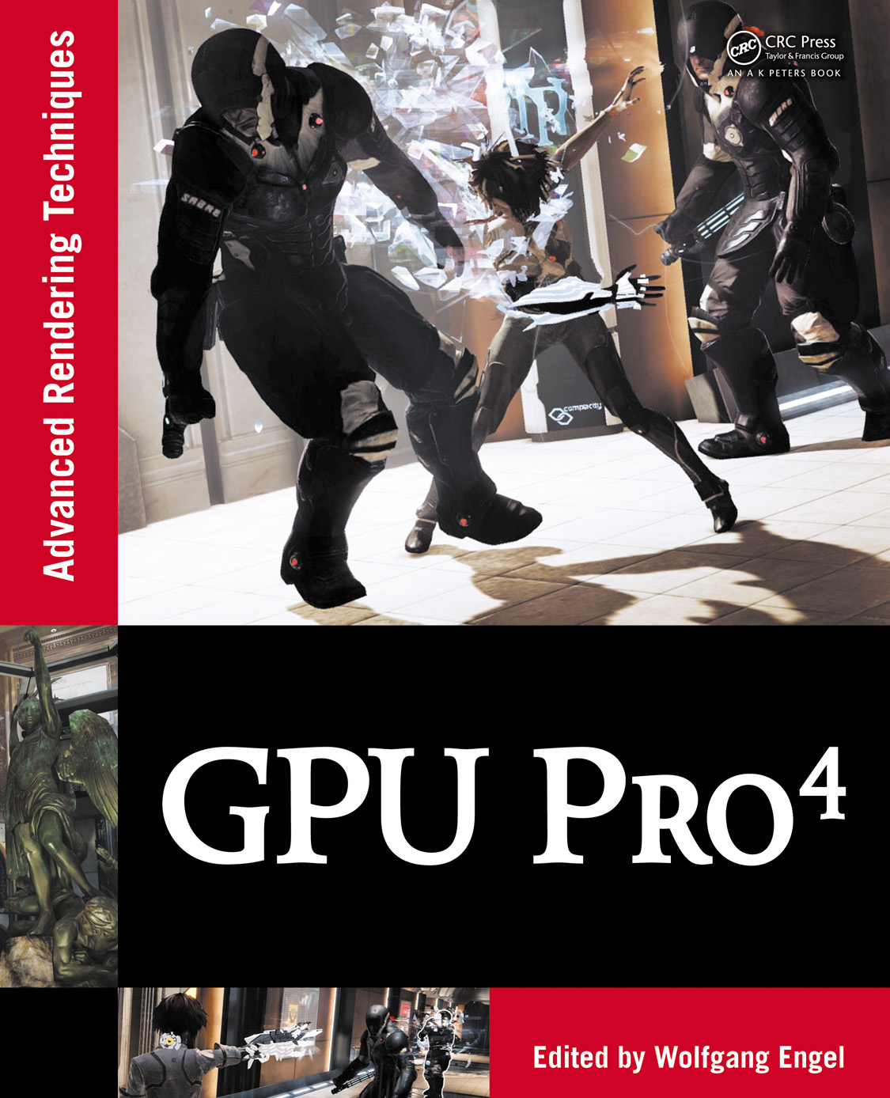
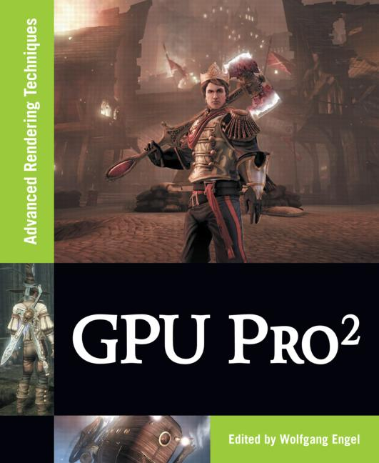
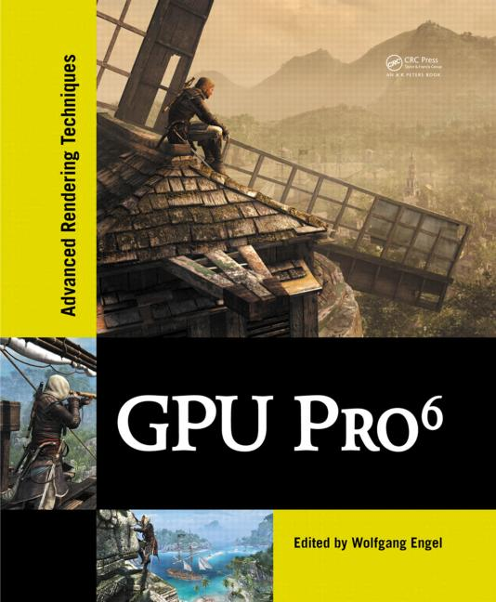
Are you book worm?
For Shaders!!

Slide 40


Are you book worm?
Advanced!!

Slide 41
We are …..
Venom

Slide 42
We are …..
Satt Paing Phyoe
Si Thu Myo
Lin Htet Moe
Khant Myat Min
Phone Pyae Kyaw
Tun Nanda Aung
Myat Kaung Khant

Slide 43
Thanks
Now go make some cool stuffs

